Slide 1

Milestone 6: Monitoring
Software Engineering
for AI Enabled Systems
Students: Basile Andrea, Iacovazzi Antonio Raffaele, Lorusso Roberto

Slide 2
Agenda
Monitoring at Resource Level
Prometheus
Grafana
Better-Uptime
Locust
Monitoring at Performance Level
Alibi-detector

Slide 3
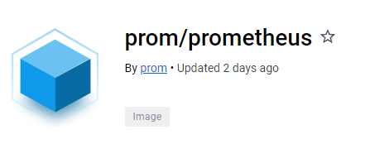
Prometheus-setup
dockerfile
FROM prom/prometheus
COPY prometheus.yml /etc/prometheus/prometheus.yml
> docker pull prom/prometheus: latest
prometheus.yml
global:
scrape_interval: 15s
scrape_timeout: 60s
scrape_configs:
- job_name: 'fastapi'
scrape_interval: 15s
scrape_timeout: 60s
static_configs:
- targets: ['docker.for.mac.localhost:9100']

Slide 4

Grafana-setup
> docker pull grafana/grafana-oss: latest
Grafana OSS (Open Source Software) is the open-source version of Grafana, while Grafana is also available in a paid version called Grafana Enterprise. The Enterprise version offers some additional features compared to the OSS version, such as support for enterprise authentication and integration with other business intelligence tools. In general, Grafana OSS is used by organizations that want a advanced monitoring solution but do not need the features offered by the Enterprise version.

Slide 5
Connect Prometheus & Grafana
Once the docker images have been downloaded, it is possible to modify the docker-compose.yaml
...
prometheus:
container_name: prometheus_container
ports:
- '9300:9090'
build:
context: ./prom
dockerfile: Dockerfile
networks:
- prometheus_grafana
depends_on:
- backend ...
...
grafana:
container_name: grafana_container
image: grafana/grafana-oss
ports:
- '3000:3000'
networks:
- prometheus_grafana
depends_on:
- prometheus
networks:
prometheus_grafana:
The network “Prometheus_Grafana” is addes in order to let the two container to communicate each other.

Slide 6
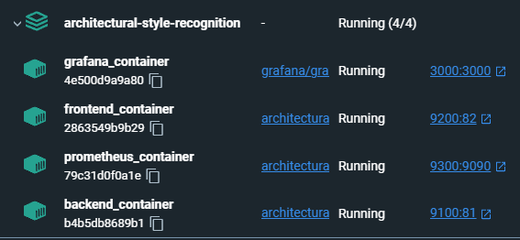
Connect Prometheus & Grafana
Once the docker images have been downloaded, it is possible to modify the docker-compose.yaml
The network “Prometheus_Grafana” is addes in order to let the two container to communicate each other.

Slide 7
Prometheus Metrics
REQUEST_TIME = Gauge(
"request_processing_seconds",
"Time spent processing request",
["method", "endpoint"],
)
AVG_DDFC = Gauge(
"avg_ddfc",
"Average of last 5 'delay detection following change' of the drift detector."
)
hist_img = Histogram(
"img_size",
"Histogram for tracking the size of the images",
buckets=[100,200,300,400,500,600,700,800,900,1000]
)
counter_predictions = Counter(
"counter_predictions",
"Counter for predictions that have been made",
)
counter_labeled_images = Counter(
"counter_labeled_images",
"Counter for images sent to extend the dataset",
)
counter_feedback = Counter(
"counter_feedback",
"Counter for feedbacks sent by the experts",
)

Slide 8
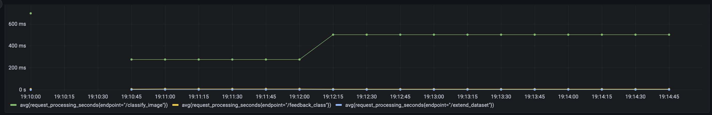
Grafana dashboard
PromQL queries for data visualization
avg(request_processing_seconds{endpoint="/classify_image"})
avg(request_processing_seconds{endpoint="/extend_dataset"})
avg(request_processing_seconds{endpoint="/feedback_class"})

Slide 9
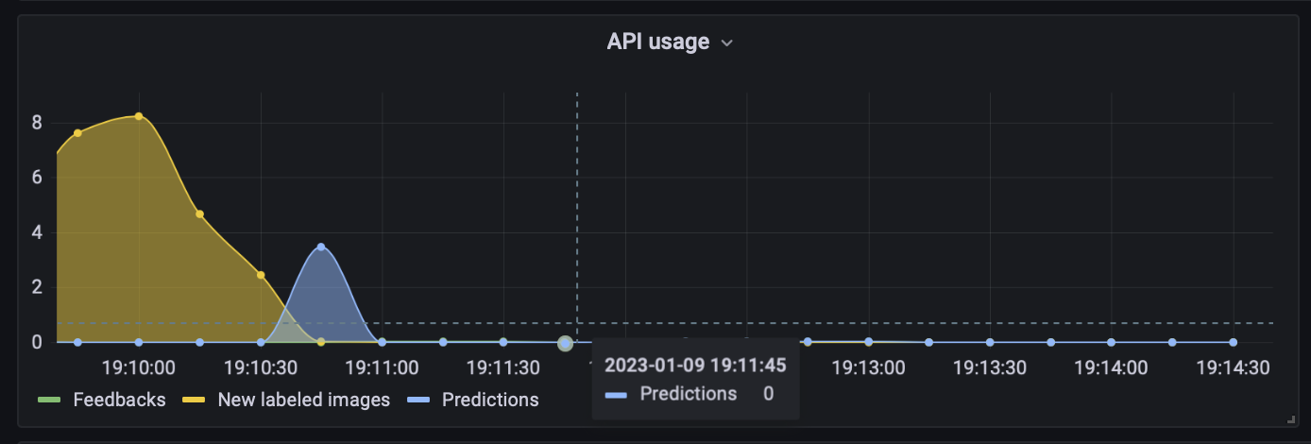
Grafana dashboard
PromQL queries for data visualization
rate(counter_feedback_total[1m])

Slide 10
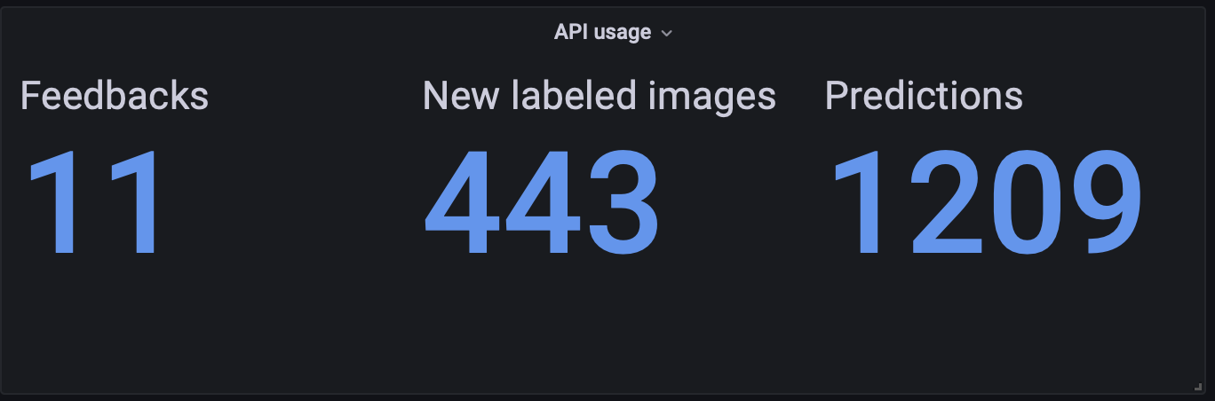
Grafana dashboard
PromQL queries for data visualization
counter_feedback_total

Slide 11
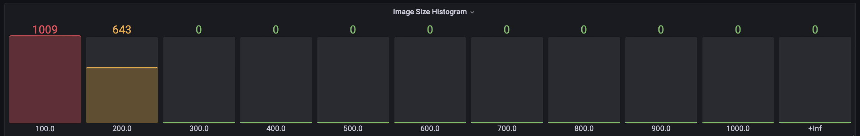
Grafana dashboard
PromQL queries for data visualization
img_size_bucket

Slide 12
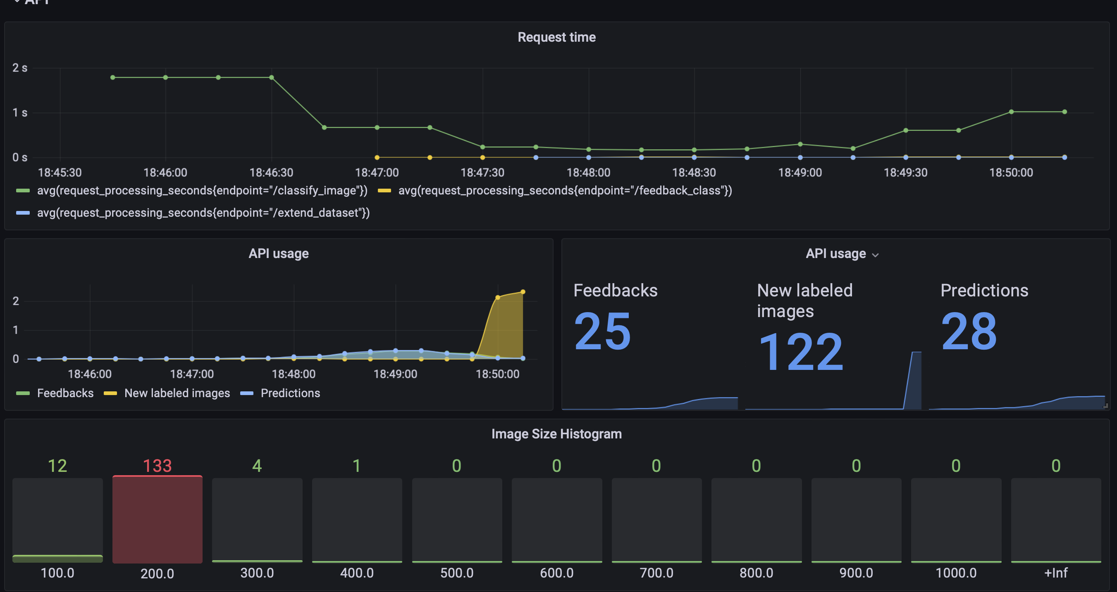
Grafana dashboard
API Usage

Slide 13
Prometheus Metrics
In order to monitor our system we decided to use:
prometheus_fastapi_instrumentator
A configurable and modular Prometheus Instrumentator for your FastAPI.
With this, your FastAPI is instrumented and metrics are ready to be scraped.
The defaults give you:
Counter http_requests_total
Counter process_cpu_second_total
Counter process_virtual_memory_bytes
from prometheus_fastapi_instrumentator import Instrumentator from prometheus_client import (
Counter,
Gauge,
Histogram,
)

Slide 14

Prometheus Metrics
Pulling strategy
The metrics are made available at /metrics endpoint using the Pull strategy
@app.on_event("startup")
async def startup():
Instrumentator().instrument(app).expose(app)
Pull from endpoint /metrics

Slide 15
Prometheus Metrics
Pulling strategy
# HELP img_size Histogram for tracking the size of the images
# TYPE img_size histogram
img_size_bucket{le="100.0"} 10882.0
img_size_count 10882.0
img_size_sum 39175.2
# HELP counter_predictions_total Counter for predictions that have been made
# TYPE counter_predictions_total counter
counter_predictions_total 10882.0
# HELP http_requests_total Total number of requests by method, status and handler.
# TYPE http_requests_total counter
http_requests_total{handler="/metrics",method="GET",status="2xx"} 127.0 http_requests_total{handler="/docs",method="GET",status="2xx"} 13.0 http_requests_total{handler="none",method="GET",status="4xx"} 4.0 http_requests_total{handler="/classify_image/",method="POST",status="2xx"} 874.0 http_requests_total{handler="/classify_image/",method="POST",status="4xx"} 87.0

Slide 16
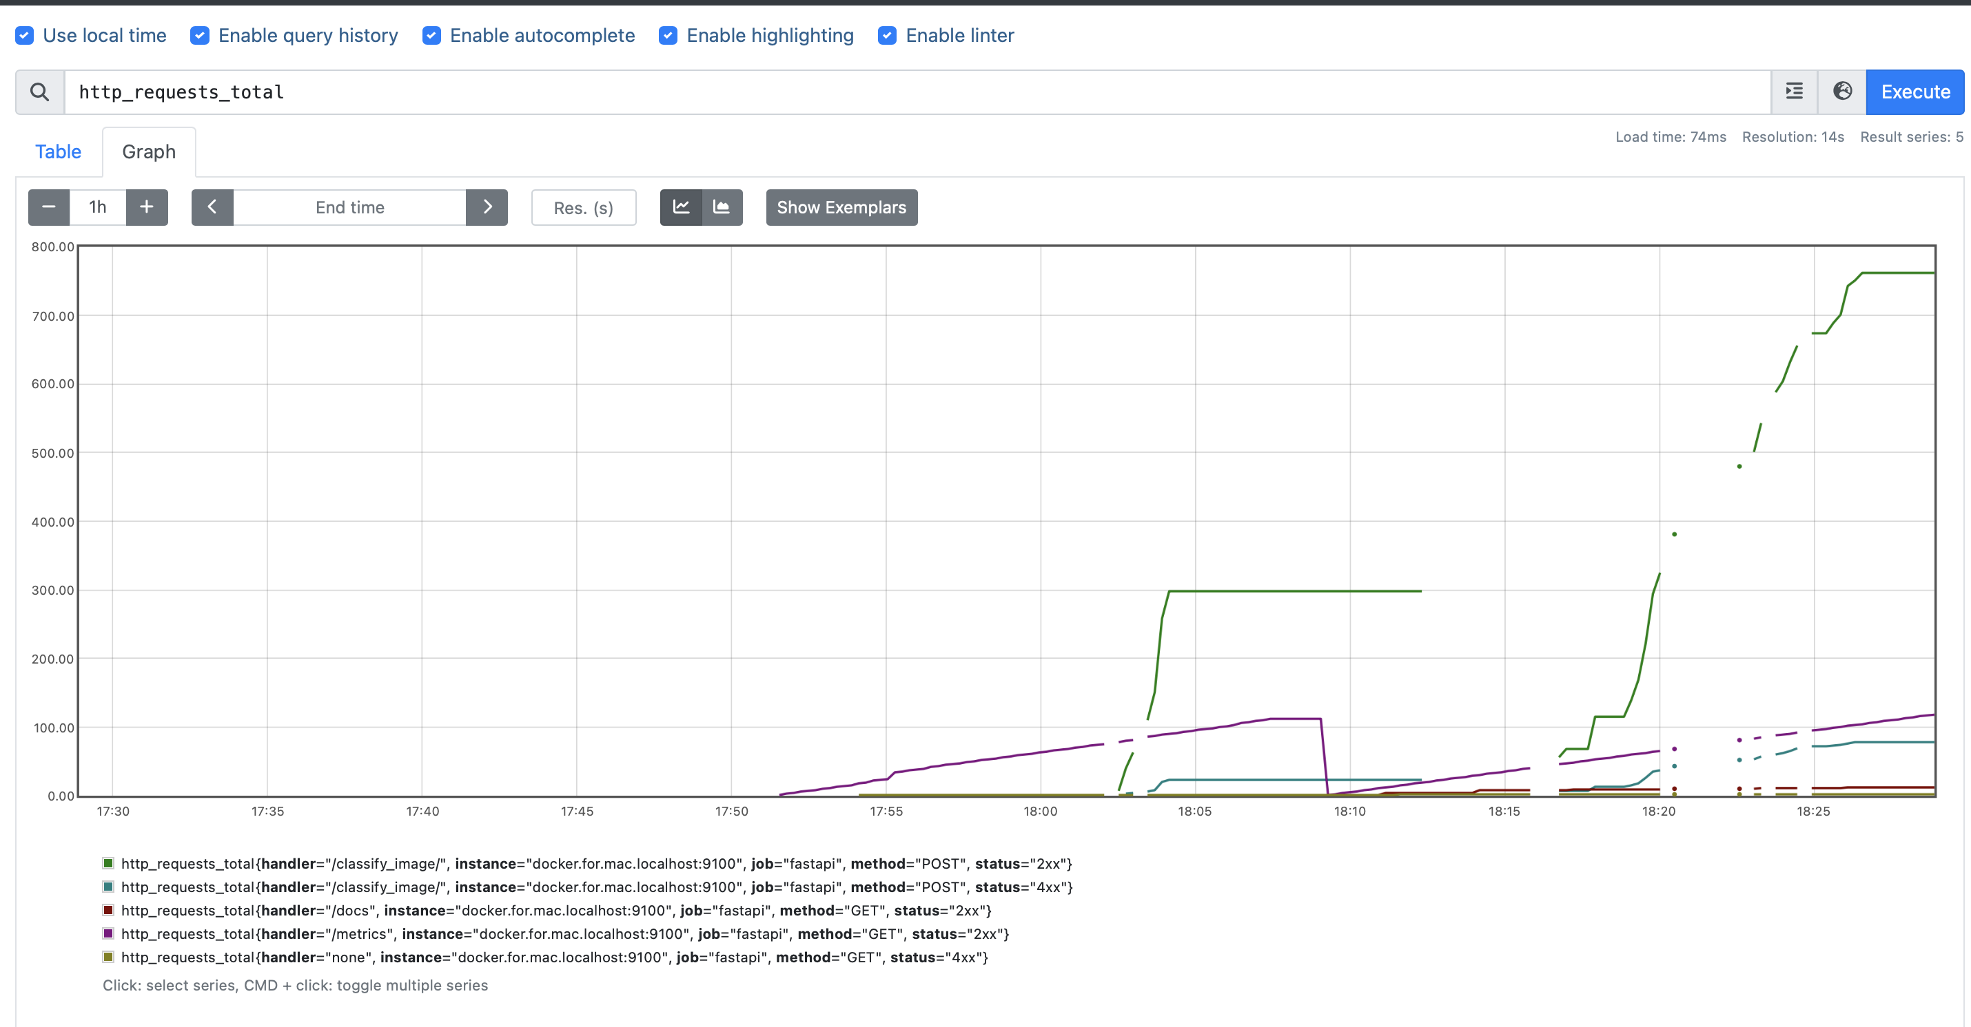
Prometheus Metrics
Pulling strategy

Slide 17
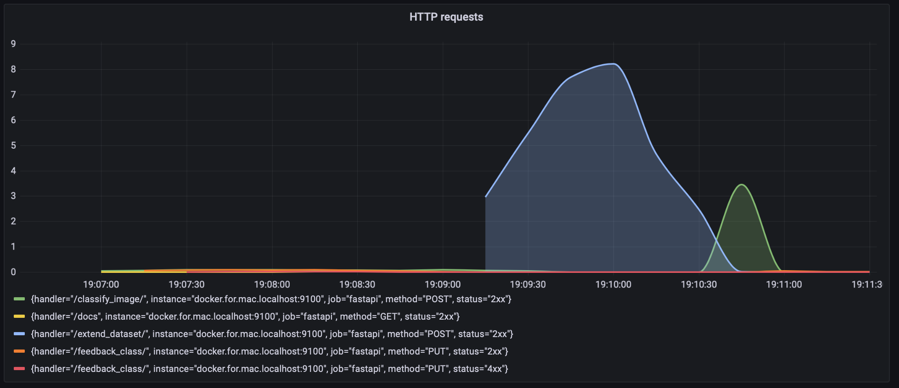
Grafana dashboard
PromQL queries for data visualization
rate(http_requests_total{handler!="/metrics", method!="OPTIONS"}[1m])

Slide 18
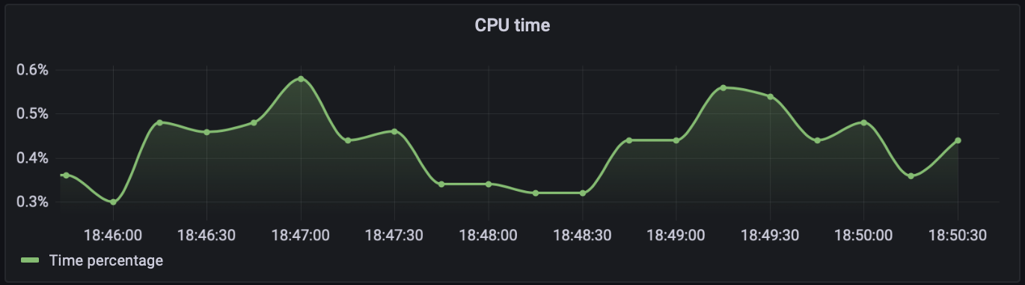
Grafana dashboard
PromQL queries for data visualization
rate(process_cpu_seconds_total{job="fastapi"}[1m])

Slide 19
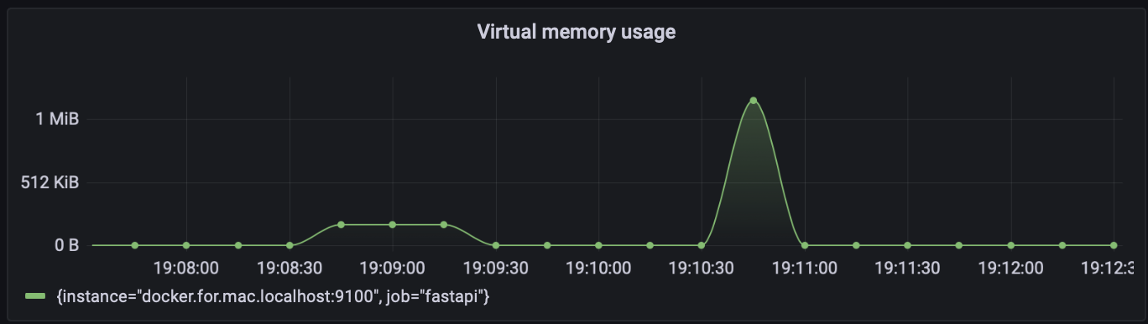
Grafana dashboard
PromQL queries for data visualization
rate(process_virtual_memory_bytes{instance="docker.for.mac.localhost:9100"}[1m])

Slide 20
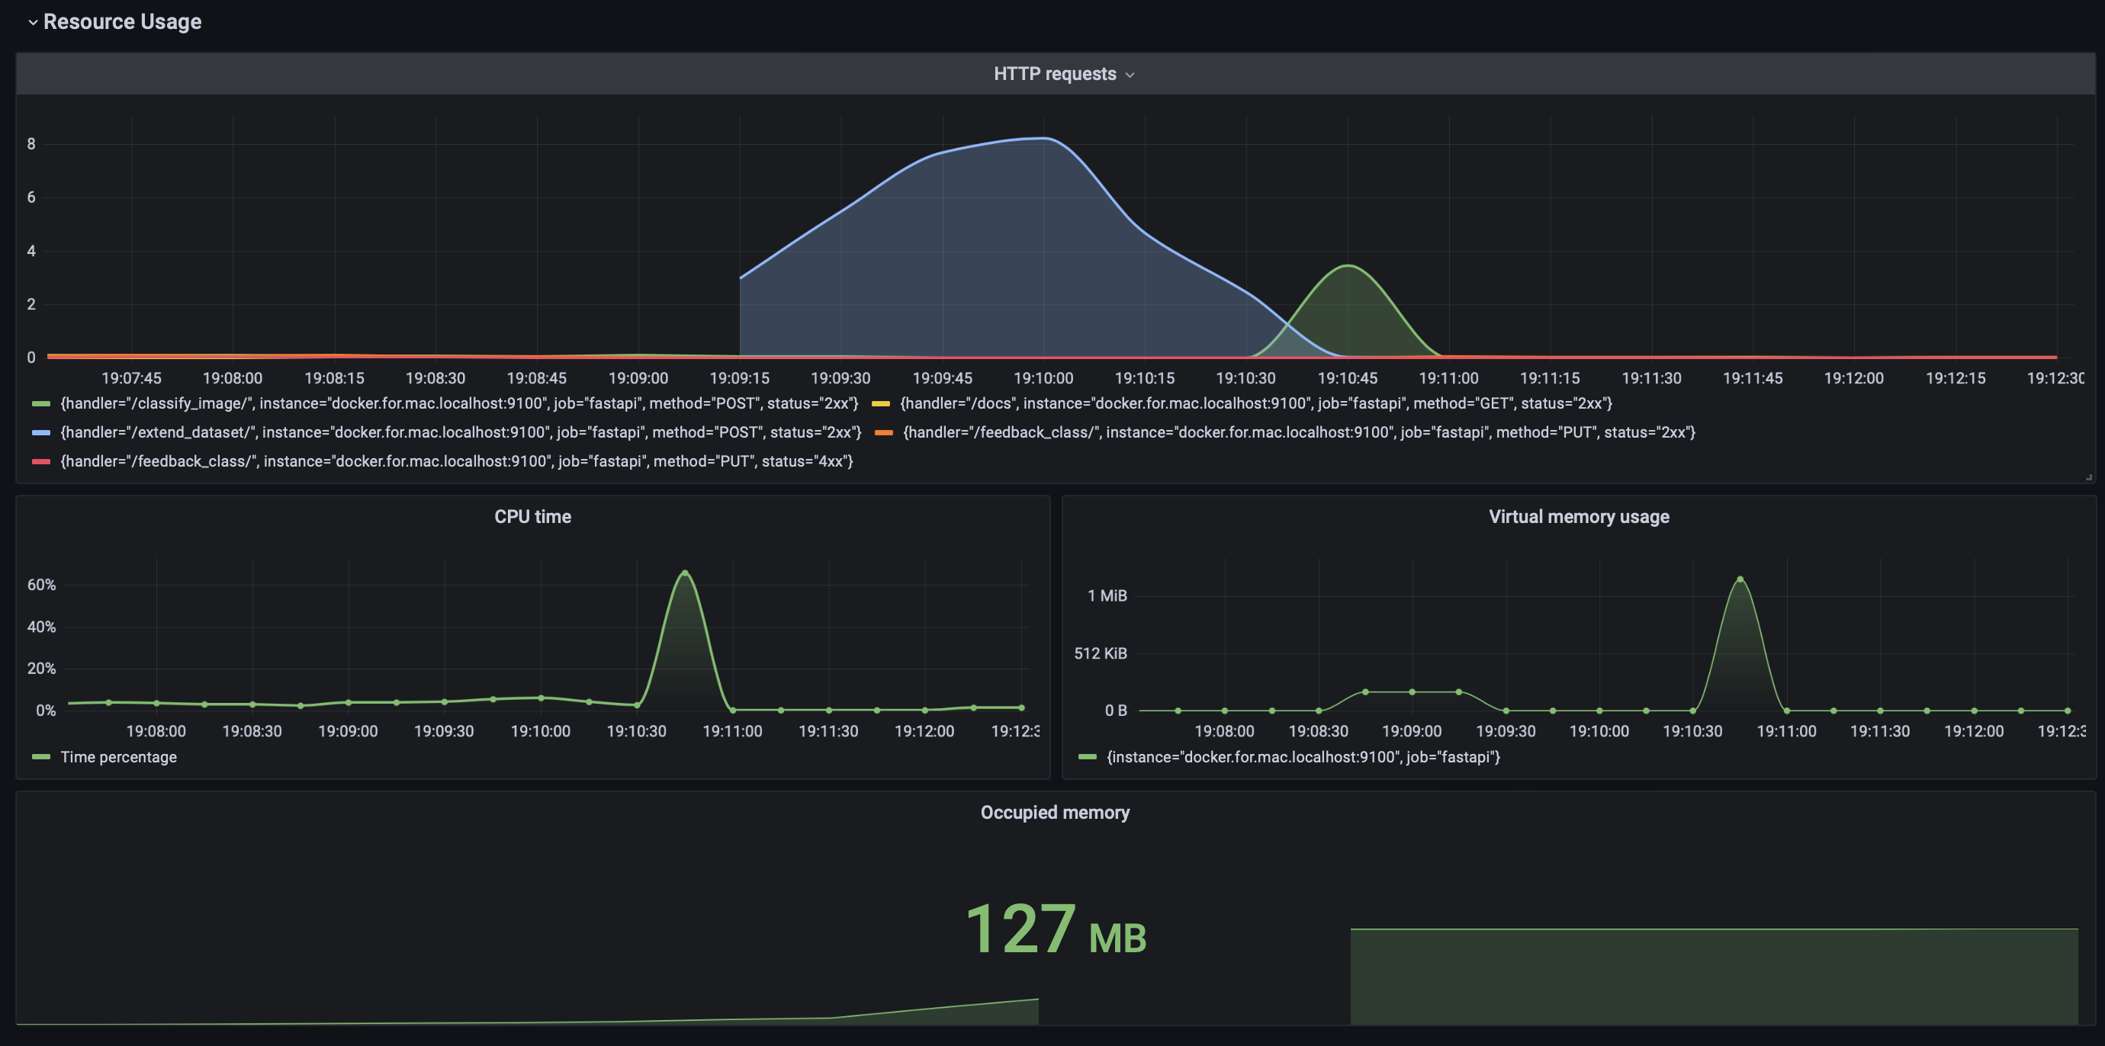
Grafana dashboard
Resource Usage

